Slide 1

Data Science & Generative AI
Dr Michael Mortenson Associate Professor (Reader)
michael.mortenson@wbs.ac.uk
Session 2: Data Cleaning and Feature Engineering (Seminar)

Slide 2




1.1 A Data Supply Chain
Data Processing, Engineering & Storage
Data Analytics and Modelling
Implementation / Decision Making
Notes:
Data (in data science) is essentially a supply chain. We get data into the system – a typically today from a wide range of sources and it needs first to be processed, cleaned and stored somewhere. We can then begin a refinement process through analytics and modelling, before lastly we need to translate that into some action to see value. This can be human action (business decision makers) or an AI agent. We’ll think about that at the micro level (engineering your data for a specific project), but also a macro level (thinking about our overall supply chain)

Slide 3
1.2 From Data to Features
“Feature engineering is the process of transforming raw data into relevant information for use by machine learning models. […] Because model performance largely rests on the quality of data used during training, feature engineering is a crucial preprocessing technique that requires selecting the most relevant aspects of raw training data for both the predictive task and model type under consideration”
Murel J (2024). What is Feature Engineering? https://www.ibm.com/topics/feature-engineering

Slide 4

1.3 ANNOUNCEMENT!
Unfortunately we cannot run next week’s lecture here in person for operational reasons.
I apologise unreservedly for this.
Instead we will run the lecture as a synchronous online session (via Kaltura) on Friday 24th at 09:00.
If this presents significant challenges for anyone I am more than happy to also record the lecture, and release it on Monday, as well as running the synchronous session Friday.

Slide 5
Session Structure
Introduction
Data Cleaning Exercise
Feature Engineering Exercise
Discussion

Slide 6

2.1 Data Cleaning

Slide 7
2.1 Data Cleaning
Please access the file “Data2Clean.xlsx” from my.wbs.
Our task is twofold:
Identify the potential issues in the data;
Think about how we might clean these data. (You do not need to actually perform any cleaning steps just consider what you might do in practice).

Slide 8
Session Structure
Introduction
Data Cleaning Exercise
Feature Engineering Exercise
Discussion

Slide 9
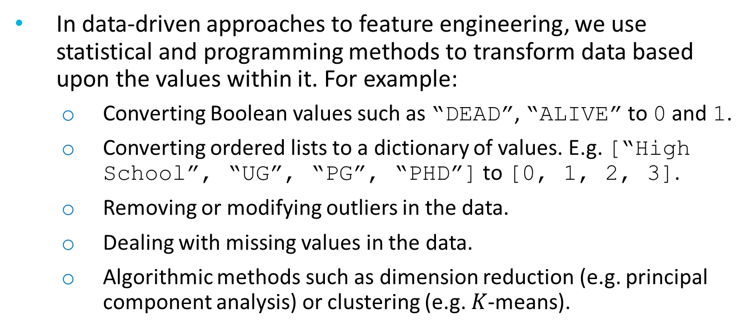
3.1 Data-driven Feature Engineering
In data-driven approaches to feature engineering, we use statistical and programming methods to transform data based upon the values within it. For example:
Converting Boolean values such as “DEAD”, “ALIVE” to 0 and 1.
Converting ordered lists to a dictionary of values. E.g. [“High School”, “UG”, “PG”, “PHD”] to [0, 1, 2, 3].
Removing or modifying outliers in the data.
Dealing with missing values in the data.
Algorithmic methods such as dimension reduction (e.g. principal component analysis) or clustering (e.g. $K$-means).

Slide 10
3.2 Theory-driven Feature Engineering
Theory-driven feature engineering involves injecting subject-matter expertise into raw data. This is usually achieved through:
Facilitations/brainstorming workshops;
Literature reviews;
Contextualising data items.
Question: What data items may be predictive of whether a student will pass a module?

Slide 11
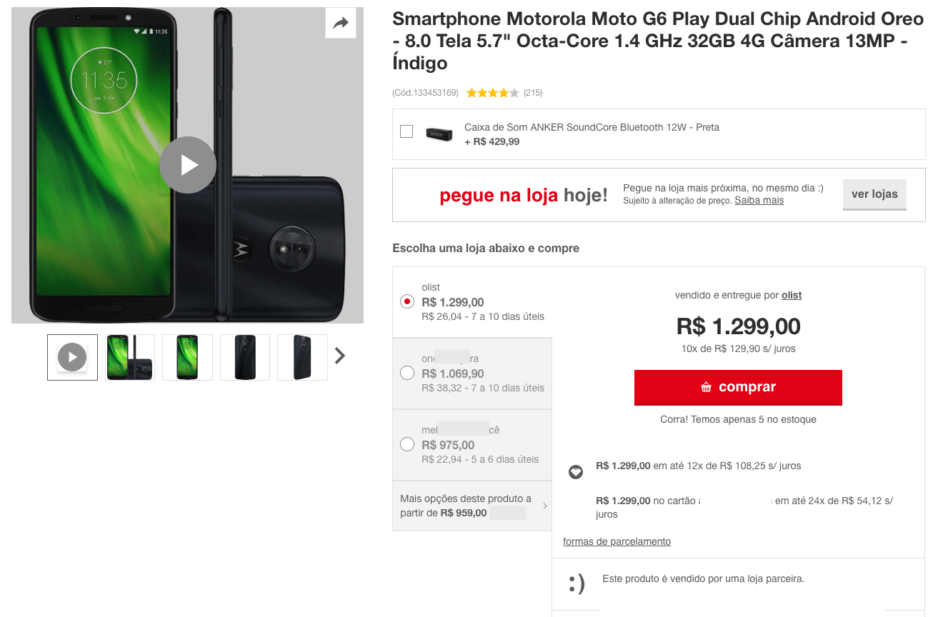
3.3 Exercise: Company background

Slide 12
3.4 Scenario
The company has requested you to develop a model to predict which customers will leave positive reviews.
This model will be used to then specifically target/incentivise these customers to write a review. (Maintaining a set of positive reviews is very important in online retail).
For this exercise, we are looking through the data in order to identify which features may be predictive of this. You do not need to perform any feature engineering (data-driven or theory-driven) but to think what features you can create which may be predictive.

Slide 13

3.5 Dataset

Slide 14
3.5 Dataset
olist_order_reviews_dataset
review_id: Unique review ID
order_id: Unique order ID
review_score: 1-5*
review_comment_message: Any comments left by the customer (in Portuguese)
review_creation_date: The date the survey (email notification) was sent to the customer
review_answer_timestamp: When the customer completed the review

Slide 15
3.5 Dataset
olist_customers_dataset
customer_id: Unique ID related to the order. Each new order generates a unique customer ID even if this customer has bought from the store before
customer_unique_id: Unique ID (one per customer) linked to their profile and order history
customer_zip_code_prefix: First five characters of their zip code (post code)
customer_city: The name of the city the customer lives in (Brazilian)
customer_state: The state which the customer lives in (Brazilian)

Slide 16
3.5 Dataset
olist_geolocation_dataset
geolocation_zip_code_prefix: The first five digits of the zip code
geolocation_lat: Latitude
geolocation_lng: Longitude
geolocation_city: The name of the city the customer lives in (Brazilian)
geolocation_state: The state which the customer lives in (Brazilian)

Slide 17
3.5 Dataset
olist_order_dataset
order_id: Unique ID of the order
customer_id: An ID unique to each order. This provides access to the unique customer ID in the customer dataset
order_status: Delivered, shipped, etc.
order_purchase_timestamp: The time of the purchase.
order_approved_at: The time the payment was authorised
order_delivered_carrier_date: When the order was posted
order_estimated_delivery_date: Show the date the customer was advised that the order would be delivered at the time of purchase

Slide 18
3.5 Dataset
olist_order_items_dataset
order_id: Unique ID of the order
order_item_id: Each item purchased in the same order
product_id: The unique ID of each product purchased
seller_id: The unique ID of the seller
shipping_limit_date: The date the seller will send the order to the logistic partner
price: Item price
freight_value: The item freight value (if an order has multiple items the freight value is split between them)

Slide 19
3.5 Dataset
olist_payments_dataset
order_id: Unique ID of the order
payments_sequential: A customer may pay with more than one method. This is the sequence of payments.
payment_type: Method of payment
payment_installments: If the payment is in instalments (multiple payments over time) this is the number of instalments.
payment_value: Transaction value

Slide 20
3.5 Dataset
olist_product_dataset
product_id: Unique ID of the product
product_category_name: Name of the product category
product_name_lenght: Number of characters extracted from the product name
product_description_lenght: Number of characters extracted from the product description
product_photos_qty: Number of product photos online
product_weight_g: Product weight in grams
product_length_cm: Product length in centimetres
product_width_cm: Product width in centimetres

Slide 21
3.5 Dataset
olist_sellers_dataset
seller_id: Unique ID of the seller
seller_zip_code_prefix: The first five digits of the seller’s zip code (post code)
seller_city: City where the seller is based
seller_state: State where the seller is based

Slide 22
3.5 Dataset
WARNINGS!!!!!
The customer_id is not unique – customer_unique_id is. Each customer can have multiple customer_id records (1x per transaction)
An order may have multiple items
Each item may be fulfilled by different sellers
All text identifying stores and partners have been replaced with Game of Thrones great houses

